Slide 1

Implementation (and analysis) of a location based community organizer
Practical course Advanced Networking (Ws14/15)
Supervised by : David Koll
Presented by :
Hari Raghavendar Rao Bandari(11334055)
Seshagiri Prabhu(21410690)

Slide 2



Introduction :-
A location based community organizer.
Users could share their current physical location information to others in a community
Tracks location
B is 10 M away
A
Server
A is 10 M away
B

Slide 3
Anyone in the community can create an event and that event will be shared in the community( Ex: Instant Event “Meeting at central Mensa”).
Meeting at central Mensa
Meeting at central mensa
Meeting at central mensa
Server
Meeting at central mensa

Slide 4
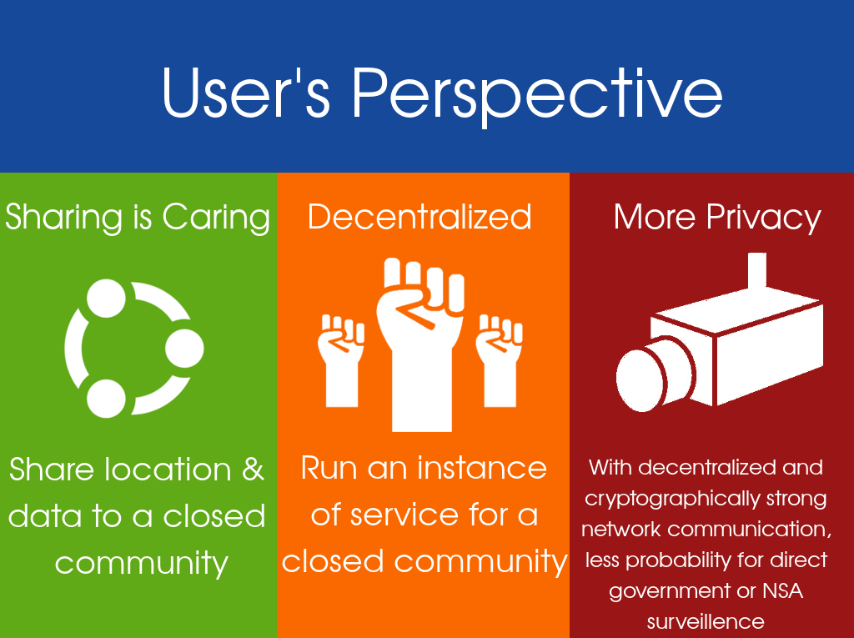

Motivation:

Slide 5
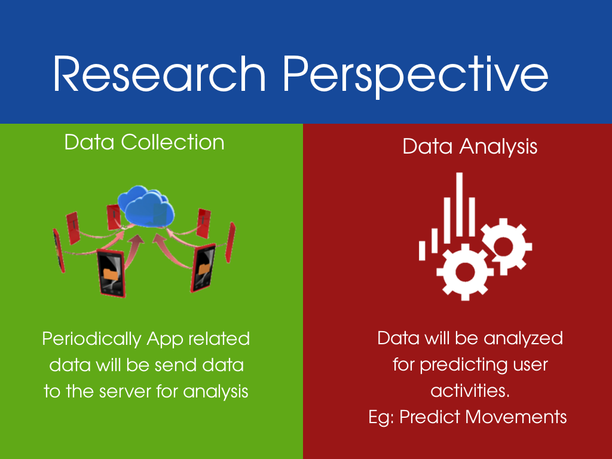

Slide 6
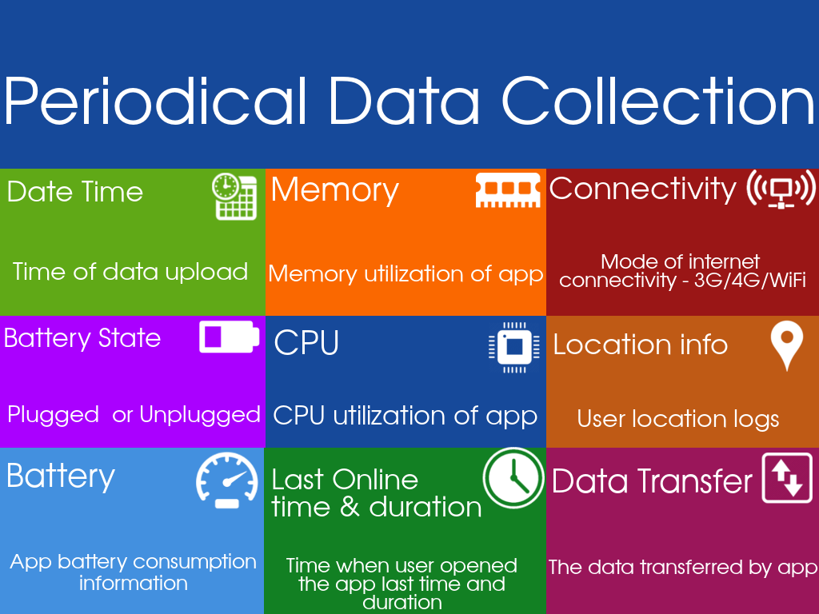

Slide 7
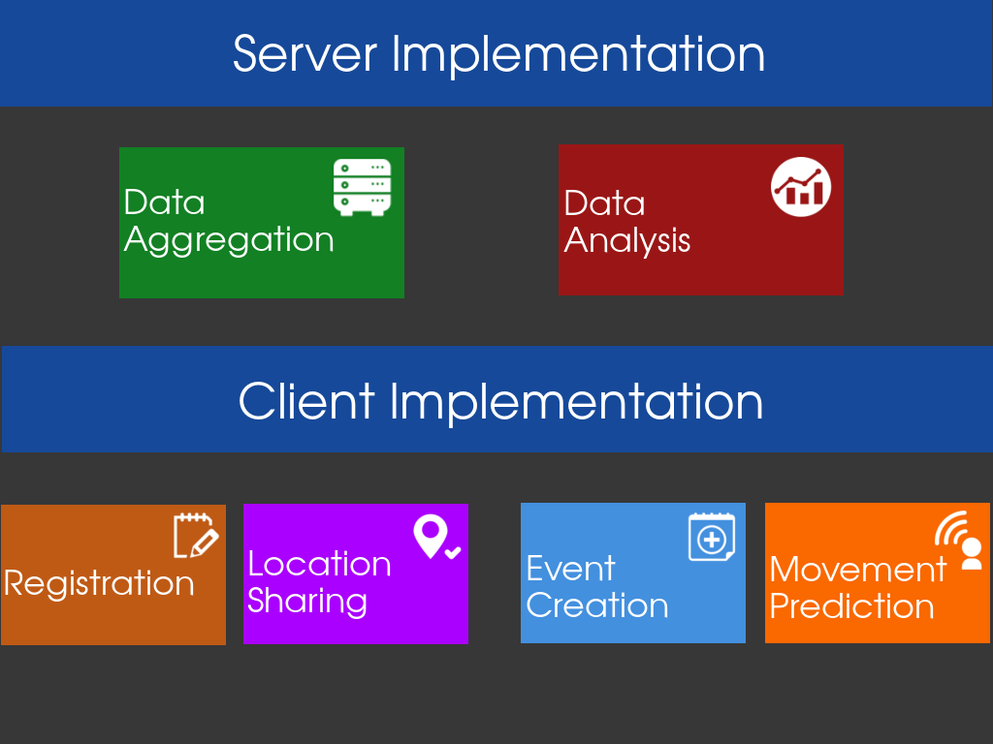
Implementation:
Server Implementation:
We collect data from user application like Location information, Battery Consumption, Last online, Connected to Wifi or Cellular Service Provider, Event organizer details. we do data Aggregation and Analysis on the data we collect.
Client Implementation:
User has to has install our application then he/she has to register and allow location sharing information and can organize event and share with others in community.

Slide 8
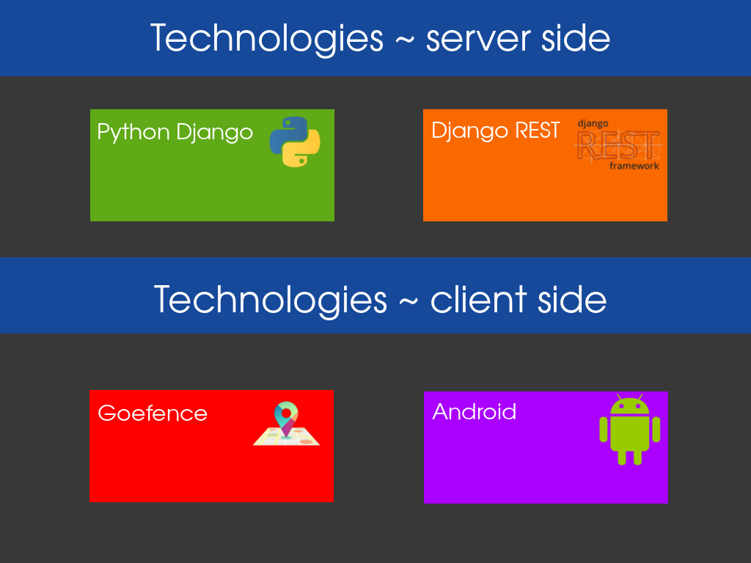

Slide 9
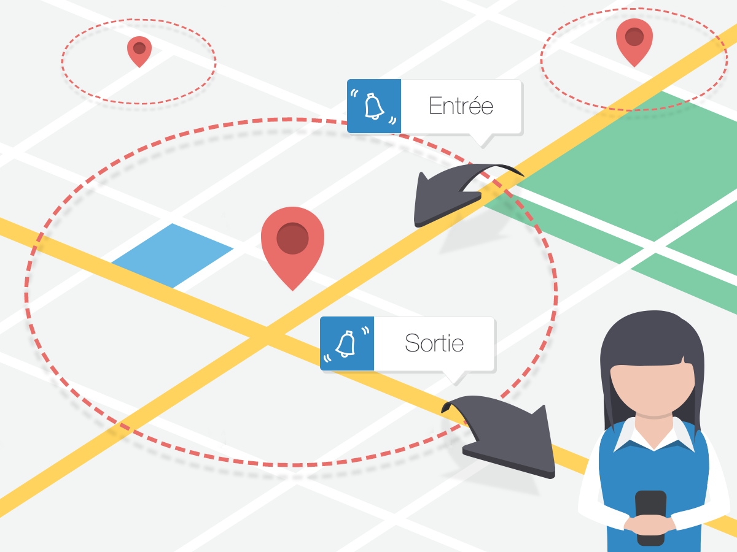
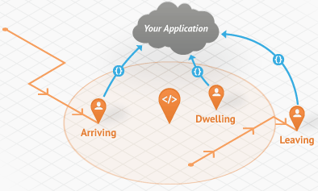
Geofence:
Geofencing is all about setting virtual areas and monitoring a smartphone entry and exit particular areas.
We can create as many virtual areas on map to track user location.

Slide 10
Advantages of Geofence:
Geofencing uses cell tower information and Wi-Fi which provide a quite fair accuracy and are less energy intensive. Its saves battery consumption.
Geofencing compromise between good accuracy and battery life.
This technique doesn’t track continuous location so it saves the battery consumption.
This technique gives us location details when we required.
eg: N. Ding, et al[1]
Drawbacks of Geofence:
This technique has a limited accuracy and highly depends on the density of transmitters.

Slide 11
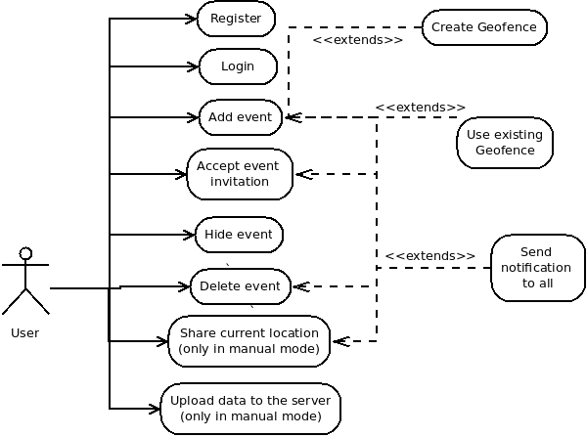
Use Case Diagram:

Slide 12
Project Plan:
Dec 20 | Server Implementation: Data collection, Data storage and Data analysis
Jan 1- 15 | Application Logic
Jan 15- 30 | Application Interface ready
Feb 1-14 | Preliminary data collection
Feb 14-27 | Detailed data Analysis for research purpose, Submission of written report

Slide 13
References:
N. Ding, et al.: "Characterizing and Modeling the Impact of Wireless Signal Strength on Smartphone Battery Drain", ACM SIGMETRICS 2013 [pdf]
Dmitry Namiot and Manfred Sneps-Sneppe: Geofence and Network Proximity, Springer Verlang Berlin Heidelberg 2013 [pdf]
K. Athukorala et al: “How Carat Affects User Behavior: Implications for Mobile Battery Awareness Applications”, ACM CHI’14 [pdf]
Daniel Wagner, Andrew Rice and Alastair Beresford, Device Analyzer: understanding smartphone usage, 10th International Conference on Mobile and Ubiquitous Systems: Computing, Networking and Services, Tokyo, Japan, December 2013 [pdf]
Daniel Wagner, Andrew Rice and Alastair Beresford, Device Analyzer: Large-scale mobile data collection, Big Data Analytics workshop (in conjunction with ACM Sigmetrics 2013), Pittsburgh, PA, USA, June 2013 [pdf]

Slide 14
Thank You

Slide 15
Any Questions?

